Slide 1

Toxic Language Detection
Ron Butbul
Rotem Mustacchi
Yuval Horesh

Slide 2
Project Description
Detect toxic comments in online chats using multiple NLP models
Dataset: Jigsaw Toxic Comment Classification (Kaggle)..
• Goal: Evaluate models and enhance digital safety via automation.
Data: Jigsaw Toxic Comment Classification dataset (Kaggle), over 150,000 labeled comments.

Slide 3
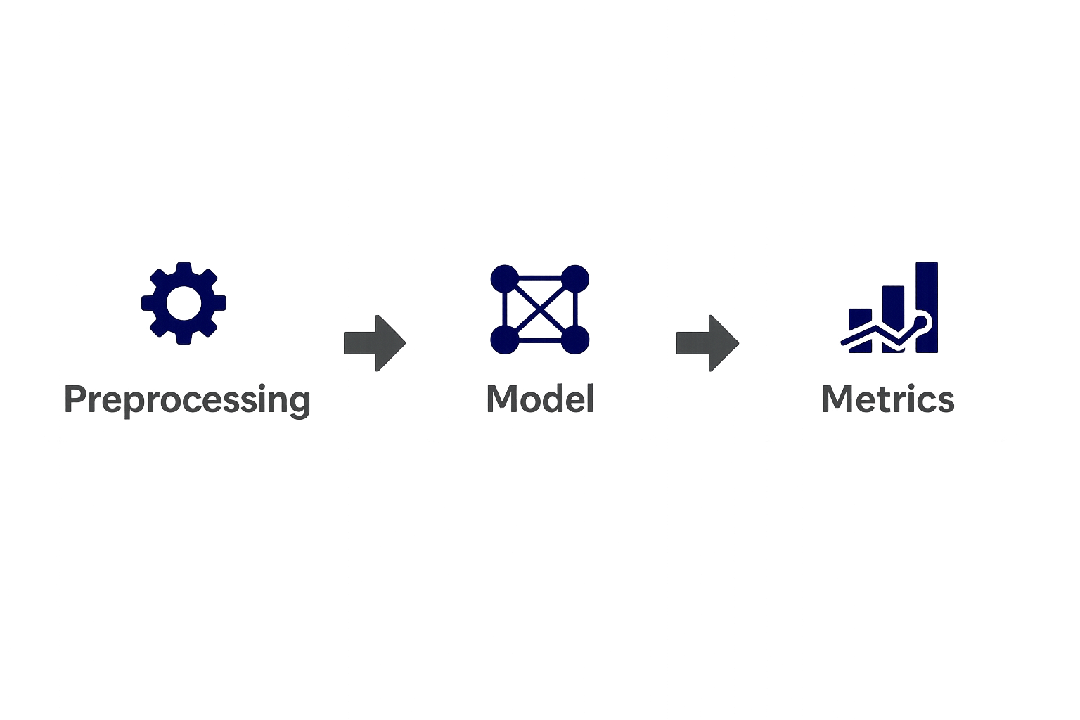
Technologies Used
Libraries: pandas, scikit-learn, transformers, torch
Models:
Naive Bayes
Logistic Regression
Support Vector Machine (SVM)
DistilBERT (Transformer)
Zero-Shot (BART-large-mnli)
Execution: CPU & GPU (Hugging Face pipeline)

Slide 4

Data Preparation
• Extracted 'comment_text' and 'toxic' columns.
• Converted labels to binary format.
• Train-test split: 80/20.
• Preprocessing: TF-IDF for ML models, tokenizer for DistilBERT.

Slide 5

Naive Bayes
• Simple probabilistic model based on Bayes’ Theorem
Vectorized comments using TF-IDF.
• Model: Multinomial Naive Bayes.
• High accuracy (~91%)
Poor recall (: ~55%) for toxic class (baseline).

Slide 6
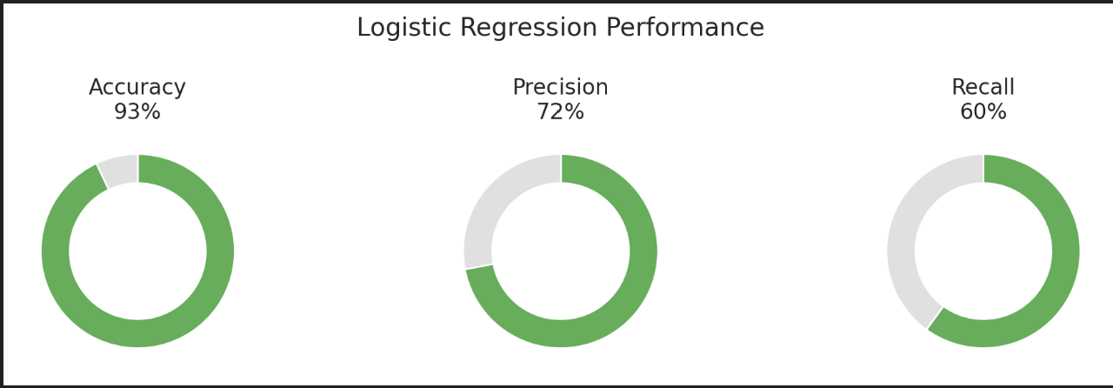
Logistic Regression
Linear model for binary classification
Same TF-IDF input as NB
Calculates probability using sigmoid function
• accuracy ~93%
• Precision (Toxic): 72%
Recall: 60%.
• Stronger than baseline.

Slide 7
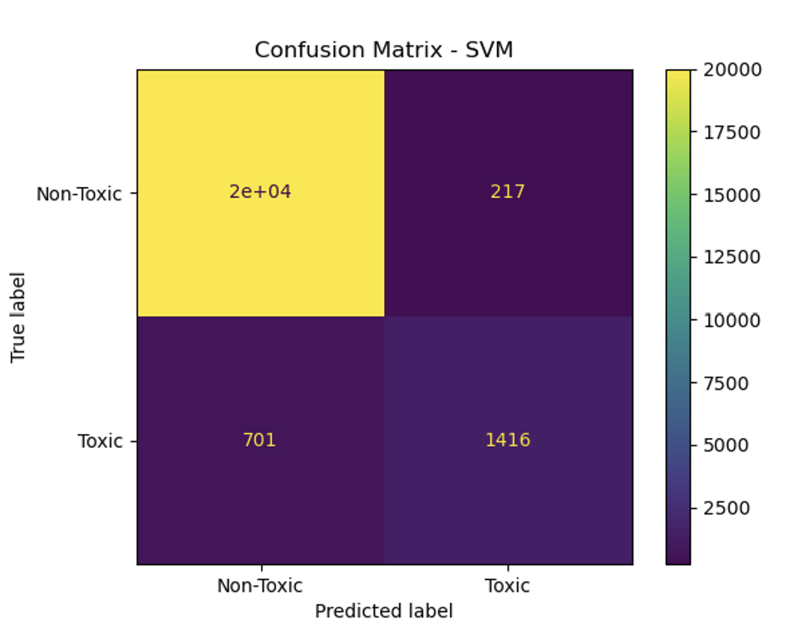
Support Vector Machine (SVM)
• LinearSVC with TF-IDF vectors.
• Finds optimal decision boundary using support vectors • Accurate with clean decision boundaries.
• Accuracy: ~93%
Precision: ~87%
Recall: ~67%
Confusion matrix shows that SVM achieved very high precision with minimal false positives. However, it still missed a notable number of toxic comments (false negatives)

Slide 8
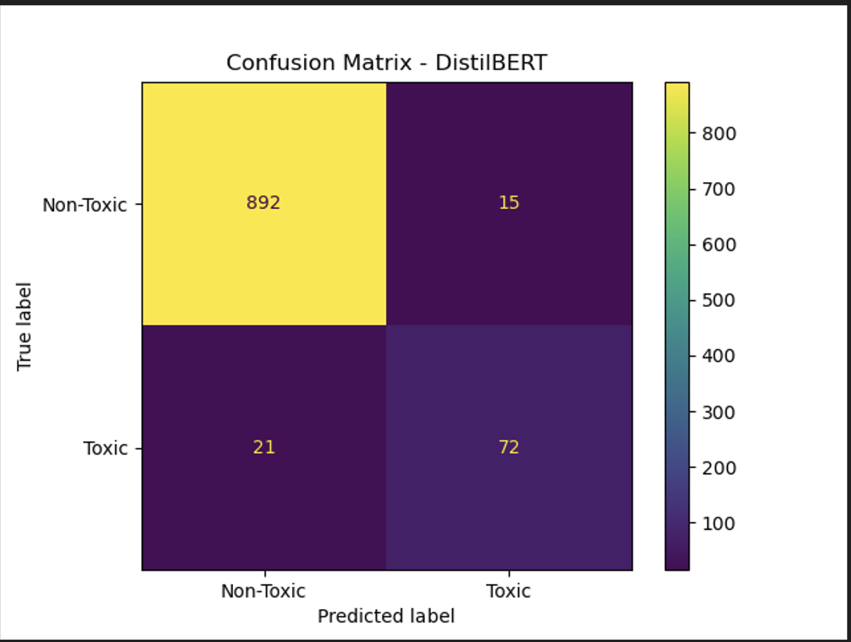
DistilBERT (Fine-Tuned)
• Hugging Face Transformers library.
• Fine-tuned on 5K samples, 2 epochs.
• Precision: 79% Recall: 71% Accuracy: ~95%.
• Best model for context-aware classification.
Confusion matrix shows balanced predictions with both high precision and recall. DistilBERT accurately identifies most toxic and non-toxic comments, minimizing both false positives and false negatives.

Slide 9
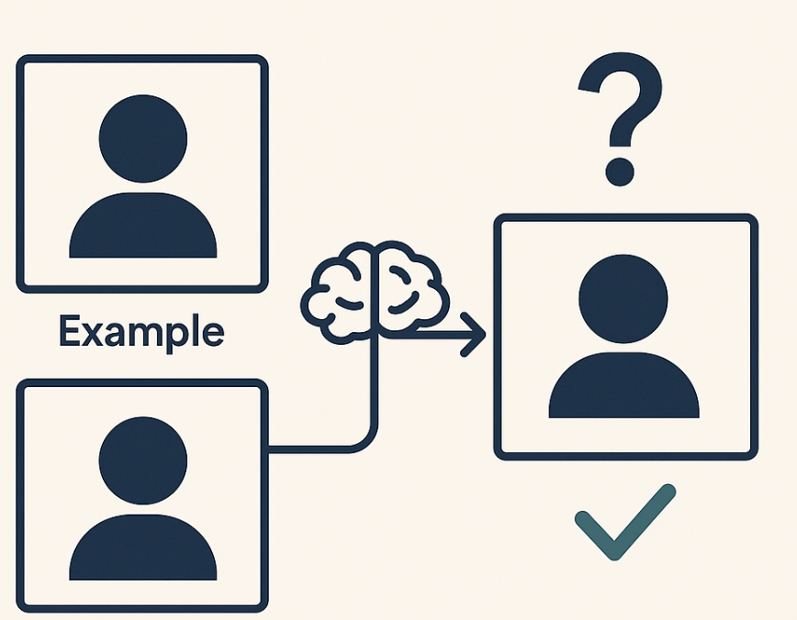
Zero-Shot Classification
• Used BART-large-MNLI model from Hugging Face • No training needed – works by checking label-text match
Input: Raw text + label prompt
Accuracy: ~92%
Precision: ~70%
Recall: ~60%

Slide 10
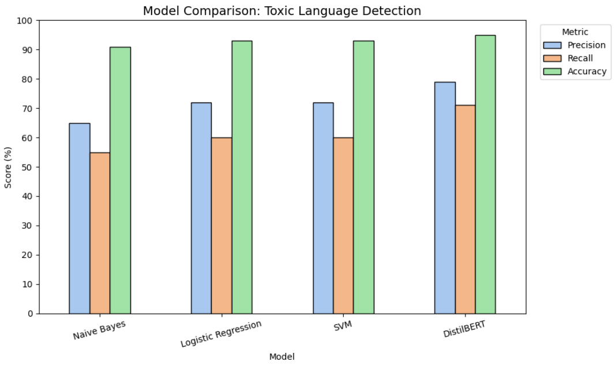
Model Comparison
Model | Precision | Recall | Accuracy
Naive Bayes | ~65% | ~55% | ~91%
Logistic Regression | 72% | 60% | 93%
SVM (LinearSVC) | ~72% | ~60% | 93%
DistilBERT | 79% | 71% | 95%

Slide 11
Conclusion
• DistilBERT leads in accuracy and recall.
• SVM and Logistic Regression are good traditional options.
• Naive Bayes is useful for benchmarking.
• Zero-shot methods allow flexible, real-time inference.

